Slide 1
Inheritance and Polymorphism

Slide 2
Objectives
Define and describe inheritance
Explain method overriding
Define and describe sealed classes
Explain polymorphism

Slide 3

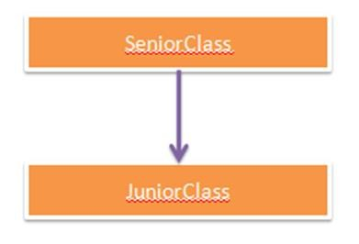
Definition of Inheritance 1-2
The similarity in physical features of a child to that of its parents is due to the child having inherited these features from its parents.
Similarly, in C#, inheritance allows you to create a class by deriving the common attributes and methods of an existing class.
The class from which the new class is created is known as the base class and the created class is known as the derived class.
The process of creating a new class by extending some
features of an existing class is known as inheritance.

Slide 4
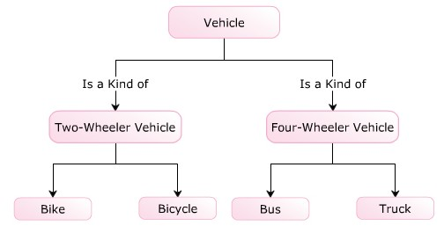
Definition of Inheritance 2-2
Example
Consider a class called Vehicle that consists of a variable called
color and a method called Speed().
These data members of the Vehicle class can be inherited by the
TwoWheelerVehicle and FourWheelerVehicle classes.
The following figure illustrates an example of inheritance:

Slide 5

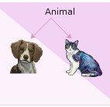
Purpose 1-3
The purpose of inheritance is to reuse common methods and attributes among classes without recreating them.
Reusability of a code enables you to use the same code in different applications with little or no changes.
Example
Consider a class named Animal which defines attributes and behavior for animals.
If a new class named Cat has to be created, it can be done based on Animal because a cat is also an animal.
Thus, you can reuse the code from the previously-defined class.

Slide 6
Purpose 2-3
Apart from reusability, inheritance is widely used for:
Inheritance allows you to implement generalization by creating base classes. For example, consider the class Vehicle, which is the base class for its derived classes Truck and Bike.
The class Vehicle consists of general attributes and methods that are implemented more specifically in the respective derived classes.
Generalization
Inheritance allows you to implement specialization by creating derived classes.
For example, the derived classes such as Bike, Bicycle, Bus, and Truck are specialized by implementing only specific methods from its generalized base class Vehicle.
Specialization
Extension
Inheritance allows you to extend the functionalities of a derived class by creating more methods and attributes that are not present in the base class. It allows you to provide additional features to the existing derived class without modifying the existing code.

Slide 7
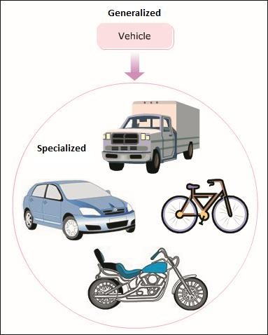
Purpose 3-3
The following figure displays a real-world example demonstrating
the purpose of inheritance:

Slide 8
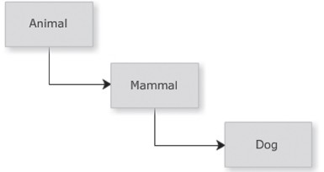
Multi-level Hierarchy 1-3
Inheritance allows the programmer to build hierarchies that can
contain multiple levels of inheritance.
Example
Consider three classes Mammal, Animal, and Dog. The class Mammal is inherited from the base class Animal, which inherits all the attributes of the Animal class.
The class Dog is inherited from the class Mammal and inherits all the
attributes of both the Animal and Mammal classes.
The following figure depicts multi-level hierarchy of related classes:

Slide 9
Multi-level Hierarchy 2-3
The following code demonstrates multiple levels of inheritance:
Snippet
using System; class Animal
{
public void Eat()
{
Console.WriteLine(“Every animal eats something.”);
}
}
class Mammal : Animal
{
public void Feature()
{
Console.WriteLine(“Mammals give birth to young ones.”);
}
}
class Dog : Mammal
{
public void Noise()
{
Console.WriteLine(“Dog Barks.”);
}
static void Main(string[] args)
{
Dog objDog = new Dog(); objDog.Eat(); objDog.Feature(); objDog.Noise();
}
}

Slide 10
Multi-level Hierarchy 3-3
In the code, the Main()method of the class Dog invokes the
methods of the class Animal, Mammal, and Dog.
Output
🞛 Every animal eats something.
🞛 Mammals give birth to young ones.
🞛 Dog Barks.

Slide 11
Implementing Inheritance 1-3
To derive a class from another class in C#, insert a colon after the name
of the derived class followed by the name of the base class.
The derived class can now inherit all non-private methods and attributes of the base class.
The following syntax is used to inherit a class in C#:
Syntax
<DerivedClassName>:<BaseClassName>
where,
🞛 DerivedClassName: Is the name of the newly created child class.
🞛 BaseClassName: Is the name of the parent class from which the
current class is inherited.

Slide 12
Implementing Inheritance 2-3
The following syntax is used to invoke a method of the base class:
Syntax
<objectName>.<MethodName>;
where,
🞛 objectName: Is the object of the base class.
🞛 MethodName: Is the name of the method of the base class.
The following code demonstrates how to derive a class from another existing class and inherit methods from the base class:
Snippet
class Animal
{
public voidEat()
{
Console.WriteLine("Everyanimaleatssomething.");
}
publicvoidDoSomething()
{
Console.WriteLine("Everyanimaldoessomething.");
}
}
class Cat:Animal
{
static voidMain(String[]args)
{
Cat objCat=new Cat(); objCat.Eat(); objCat.DoSomething();
}
}

Slide 13
Implementing Inheritance 3-3
In the code:
🞛 The class Animal consists of two methods, Eat()and DoSomething(). The class Cat is inherited from the class Animal.
🞛 The instance of the class Cat is created and it invokes the two methods defined in the class Animal.
🞛 Even though an instance of the derived class is created, it is the methods of the base class that are invoked because these methods are not implemented again in the derived class.
🞛 When the instance of the class Cat invokes the Eat()and DoSomething()methods, the statements in the Eat()and DoSomething()methods of the base class Animal are executed.
Output
Every animal eats something. Every animal does something.

Slide 14
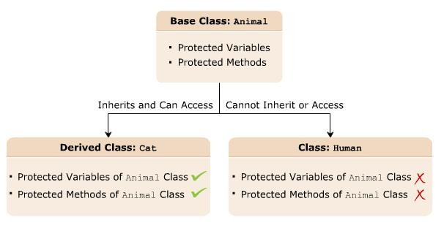
protected Access Modifier 1-3
The protected access modifier protects the data members that are
declared using this modifier.
The protected access modifier is specified using the protected
keyword.
Variables or methods that are declared as protected are accessed only by the class in which they are declared or by a class that is derived from this class.
The following figure displays an example of using the protected access
modifier:

Slide 15
protected Access Modifier 2-3
The following syntax declares a protected variable:
Syntax
protected<data_type><VariableName>;
where,
🞛 data_type: Is the data type of the data member.
🞛 VariableName: Is the name of the variable.
The following syntax declares a protected method:
Syntax
protected<return_type><MethodName>(argument_list);
where,
🞛 return_type: Is the type of value the method will return.
🞛 MethodName: Is the name of the method.
🞛 argument_list: Is the list of parameters.

Slide 16
protected Access Modifier 3-3
The following code demonstrates the use of the protected access modifier:
Snippet
class Animal
{
protected string Food; protected string Activity;
}
class Cat:Animal
{
static voidMain(String[]args)
{
cat objCat=newCat(); objCat.Food="Mouse"; objCat.Activity="lazearound";
Console.WriteLine("The Cat loves to eat"+objCat.Food+"."); Console.WriteLine("The Catloves to"+objCat.Activity+".");
}
}
In the code:
🞛 Two variables are created in the class Animal with the protected keyword.
🞛 The class Cat is inherited from the class Animal.
🞛 The instance of the class Cat is created that is referring the two variables defined in the class Animal
using the dot (.) operator.
🞛 The protected access modifier allows the variables declared in the class Animal to be accessed by the derived class Cat.
Output
Cat loves to eat Mouse.
The Cat loves to laze around.
The

Slide 17
base Keyword 1-3
The base keyword allows you to do the following:
Access the variables and methods of the base class from the derived class.
Re-declare the methods and variables defined in the base class.
Invoke the derived class data members.
Access the base class members using the base keyword.

Slide 18
base Keyword 2-3
The following syntax shows the use of the base keyword:
Syntax
class <ClassName>
{
<accessmodifier><returntype><BaseMethod>{}
}
class <ClassName1>:<ClassName>
{
base.<BaseMethod>;
}
where,
🞛 <ClassName>: Is the name of the base class.
🞛 <accessmodifier>: Specifies the scope of the class or method.
🞛 <returntype>: Specifies the type of data the method will return.
🞛 <BaseMethod>: Is the base class method.
🞛 <ClassName1>: Is the name of the derived class.
🞛 base: Is a keyword used to access the base class members.

Slide 19
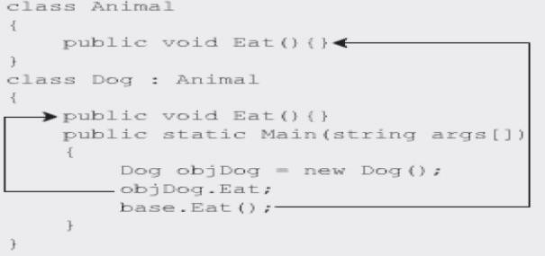
base Keyword 3-3
The following figure displays an example of using the
base keyword:

Slide 20
new Keyword 1-2
The new keyword can either be used as an operator or as a modifier in C#.
new
Modifier
Operator
Instantiates a class by creating its object which invokes the constructor of the class.
Hides the methods or variables of the base class that are inherited in the derived class.
This allows you to redefine the inherited methods or variables in the derived class.
Since redefining the base class members in the derived class results in base class members being hidden, the only way you can access these is by using the base keyword.

Slide 21
new Keyword 2-2
The following syntax shows the use of the new modifier:
Syntax
<access modifier>class<ClassName>
{
<access modifier><returntype><BaseMethod>{}
}
<access modifier>class<ClassName1>:<ClassName>
{
new<access modifier>void<BaseMethod>{}
}
where,
🞛 <accessmodifier>: Specifies the scope of the class or method.
🞛 <returntype>: Specifies the type of data the method will return.
🞛 <ClassName>: Is the name of the base class.
🞛 <ClassName1>: Is the name of the derived class.
🞛 new: Is a keyword used to hide the base class method.
The following code creates an object using the new operator:
Snippet
EmployeesobjEmp=newEmployees();
🞛 Here, the code creates an instance called objEmp of the class Employees and invokes its
constructor.

Slide 22
protected Access Modifier 1-2
The following code demonstrates the use of the new modifier to redefine the inherited
methods in the base class:
Snippet
class Employees
{
int_empId=1; string_empName="JamesAnderson"; int_age=25; publicvoidDisplay()
{
Console.WriteLine("EmployeeID:"+_empId);
Console.WriteLine("EmployeeName:"+_empName);
}
}
classDepartment:Employees
{
int_deptId=501; string_deptName="Sales"; newvoidDisplay()
{
base.Display();
Console.WriteLine("DepartmentID:"+_deptId); Console.WriteLine("DepartmentName:"+_deptName);
}
static voidMain(string[]args)
{
Department objDepartment=new Department(); objDepartment.Display();
}
}

Slide 23
protected Access Modifier 2-2
In the code:
🞛 The class Employees declares a method called Display().
🞛 This method is inherited in the derived class Department and is preceded by the new
keyword.
🞛 The new keyword hides the inherited method Display()that was defined in the base class, thereby executing the Display()method of the derived class when a call is made to it.
🞛 However, the base keyword allows you to access the base class members.
🞛 Therefore, the statements in the Display()method of the derived class and the base class are executed, and, finally, the employee ID, employee name, department ID, and department name are displayed in the console window.
Output
Employee ID: 1
Employee Name: James Anderson
Department ID: 501 Department Name: Sales

Slide 24
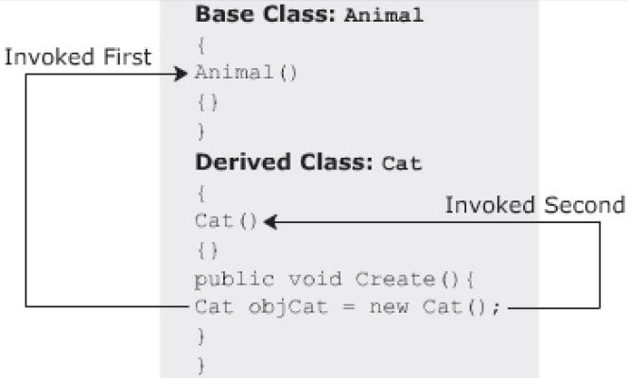
Constructor Inheritance 1-3
In C#, you can:
Invoke the base class constructor by either instantiating the derived class or the base class.
Invoke the constructor of the base class followed by the constructor of the derived class.
Invoke the base class constructor by using the base keyword in the derived class constructor declaration.
Pass parameters to the constructor.
However, C# cannot inherit constructors similar to how you inherit methods.
The following figure displays an example of constructor inheritance:

Slide 25
Constructor Inheritance 2-3
The following code explicitly invokes the base class constructor using the
base keyword:
Snippet
class Animal
{
public Animal()
{
Console.WriteLine("Animal constructor without parameters");
}
public Animal(Stringname)
{
Console.WriteLine("Animal constructor with a string parameter");
}
}
class Canine:Animal
{
//base()takes a string value called“Lion” public Canine():base("Lion")
{
Console.WriteLine("DerivedCanine");
}
}
class Details
{
static voidMain(String[]args)
{
Canine objCanine=new Canine();
}
}

Slide 26
Constructor Inheritance 3-3
In the code:
🞛 The class Animal consists of two constructors, one without a parameter and the other with a string parameter.
🞛 The class Canine is inherited from the class Animal.
🞛 The derived class Canine consists of a constructor that invokes the constructor of the base class Animal by using the base keyword.
🞛 If the base keyword does not take a string in the parenthesis, the
constructor of the class Animal
invoked.
🞛 In the class Details, when the derived class constructor is invoked, it will in turn invoke the parameterized constructor of the base class.
that does not contain parameters is
Output
🞛 Animal constructor with a string parameter
🞛 Derived Canine

Slide 27
Invoking Parameterized Base Class Constructors 1-3
The derived class constructor can explicitly invoke the base class constructor by using the base keyword.
If a base class constructor has a parameter, the base keyword is followed by the value of the type specified in the constructor declaration.
If there are no parameters, the base keyword is followed by a pair of parentheses.

Slide 28
Invoking Parameterized Base Class Constructors 2-3
The following code demonstrates how parameterized constructors are invoked in a multi-level hierarchy:
Snippet
using System; class Metals
{
string_metalType;
public Metals(stringtype)
{
_metalType=type;
Console.WriteLine("Metal:\t\t"+_metalType);
}
}
class SteelCompany : Metals
{
string_grade;
public SteelCompany(stringgrade):base("Steel")
{
_grade=grade;
Console.WriteLine("Grade:\t\t"+_grade);
}
}
class Automobiles:SteelCompany
{
string_part;
public Automobiles(stringpart):base("CastIron")
{
_part=part; Console.WriteLine("Part:\t\t"+_part);
}
static voidMain(string[]args)
{
Automobiles objAutomobiles=new Automobiles("Chassies");
}
}

Slide 29
Invoking Parameterized Base Class Constructors 3-3
In the code:
🞛 The Automobiles class inherits the SteelCompany class.
🞛 The SteelCompany class inherits the Metals class.
🞛 In the Main()method, when an instance of the Automobiles class is created, it invokes the constructor of the Metals class, followed by the constructor of the SteelCompany class.
🞛 Finally, the constructor of the Automobiles class is invoked.
Output
🞛 Metal: Steel
🞛 Grade: CastIron
🞛 Part: Chassies

Slide 30
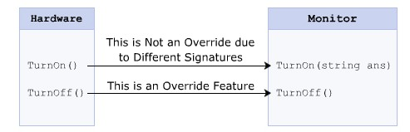
Method Overriding
Method overriding:
🞛 Is a feature that allows the derived class to override or redefine the methods of the base class which changes the body of the method that was declared in the base class.
🞛 Allows the same method with the same name and signature declared in the base class to be reused in the derived class to define a new behavior.
🞛 Ensures reusability while inheriting classes.
🞛 Is implemented in the derived class from the base class is known as the Overridden Base Method.
The following figure depicts method overriding:

Slide 31
virtual and override Keywords 1-5
You can override a base class method in the derived class using appropriate C# keywords such as:
To override a particular method of the base class in the derived class, you need to declare the method in the base class using the virtual keyword.
A method declared using the virtual keyword is referred to as a virtual method.
 | In the derived class, you need to declare the inherited virtual method using the override
 | keyword.
In the derived class, you need to declare the inherited virtual method using the override
keyword which is mandatory for any virtual method that is inherited in the derived class.
The override keyword overrides the base class method in the derived class.

Slide 32
virtual and override Keywords 2-5
The following is the syntax for declaring a virtual method using the
virtual keyword:
Syntax
<access_modifier>virtual<return_type><MethodNa me>(<parameter-list>);
where,
🞛 access_modifier: Is the access modifier of the method, which can be
private, public, protected, or internal.
🞛 virtual: Is a keyword used to declare a method in the base class that can be overridden by the derived class.
🞛 return_type: Is the type of value the method will return.
🞛 MethodName: Is the name of the virtual method.
🞛 parameter-list: Is the parameter list of the method; it is optional.

Slide 33
virtual and override Keywords 3-5
The following is the syntax for overriding a method using the
override keyword:
Syntax
<accessmodifier>override<returntype><MethodName>
(<parameters-list>)
where,
🞛 override: Is the keyword used to override a method in the derived class.

Slide 34
virtual and override Keywords 4-5
The following code demonstrates the application of the virtual and
override keywords in the base and derived classes respectively:
Snippet
class Animal
{
public virtual void Eat()
{
Console.WriteLine("Every animal eats something");
}
protected void DoSomething()
{
Console.WriteLine("Every animal does something");
}
}
class Cat:Animal
{
//Class Cat overrides Eat()method of class Animal public override void Eat()
{
Console.WriteLine("Cat loves to eat the mouse");
}
static void Main(String[]args)
{
Cat objCat = newCat(); objCat.Eat();
}
}

Slide 35
virtual and override Keywords 5-5
In the code:
🞛 The class Animal consists of two methods, the Eat()method with the virtual keyword and the DoSomething()method with the protected keyword. The class Cat is inherited from the class Animal.
🞛 An instance of the class Cat is created and the dot (.) operator is used to invoke the Eat()and the DoSomething()methods.
🞛 The virtual method Eat()is overridden in the derived class using the
override keyword.
🞛 This enables the C# compiler to execute the code within the
Eat()method of the derived class.
Output
Cat loves to eat the mouse

Slide 36
Calling the Base Class Method 1-3
Method overriding allows the derived class to redefine the
methods of the base class.
It allow the base class methods to access the new method but not the original base class method.
To execute the base class method as well as the derived class method, you can create an instance of the base class.
It allows you to access the base class method, and an instance of
the derived class, to access the derived class method.

Slide 37
Calling the Base Class Method 2-3
The following code demonstrates how to access a base class method:
Snippet
class Student
{
string _studentName = “James”; string _address = “California”; public virtual void PrintDetails()
{
Console.WriteLine(“Student Name: “ + _studentName); Console.WriteLine(“Address: “ + _address);
}
}
class Grade : Student
{
string _class = “Four”; float _percent = 71.25F;
public override void PrintDetails()
{
Console.WriteLine(“Class: “ + _class); Console.WriteLine(“Percentage: “ + _percent);
}
static void Main(string[] args)
{
Student objStudent = new Student(); Grade objGrade = new Grade(); objStudent.PrintDetails(); objGrade.PrintDetails();
}
}

Slide 38
Calling the Base Class Method 3-3
In the code:
🞛 The class Student consists of a virtual method called PrintDetails().
🞛 The class Grade inherits the class Student and overrides the base class method
PrintDetails().
🞛 The Main()method creates an instance of the base class Student and the
derived class Grade.
🞛 The instance of the base class Student uses the dot (.) operator to invoke the base class method PrintDetails().
🞛 The instance of the derived class Grade uses the dot (.) operator to invoke the
derived class method PrintDetails().
Output
Student Name: James Address: California Class: Four Percentage: 71.25

Slide 39
Sealed Classes 1-3
A sealed class is a class that prevents inheritance. The features of a sealed class are as
follows:
A sealed class can be declared by preceding the class keyword with the sealed keyword.
The sealed keyword prevents a class from being inherited by any other class.
The sealed class cannot be a base class as it cannot be inherited by any other class. If a class tries to derive a sealed class, the C# compiler generates an error.
The following syntax is used to declare a sealed class:
Syntax
sealed class<ClassName>
{
//body of the class
}
where,
🞛 sealed: Is a keyword used to prevent a class from being inherited.
🞛 ClassName: Is the name of the class that needs to be sealed.

Slide 40
Sealed Classes 2-3
The following code demonstrates the use of a sealed class in C# which will generate a
compiler error:
Snippet
sealed class Product
{
public int Quantity; public int Cost;
}
class Goods
{
static void Main(string [] args)
{
Product objProduct = new Product(); objProduct.Quantity = 50;
objProduct.Cost = 75;
Console.WriteLine(“Quantity of the Product: “ + objProduct. Quantity); Console.WriteLine(“Cost of the Product: “ + objProduct.Cost);
}
}
class Pen : Product
{
}
In the code:
🞛 The class Product is declared as sealed and it consists of two variables.
🞛 The class Goods contains the code to create an instance of Product and uses the dot (.)
operator to invoke variables declared in Product.

Slide 41
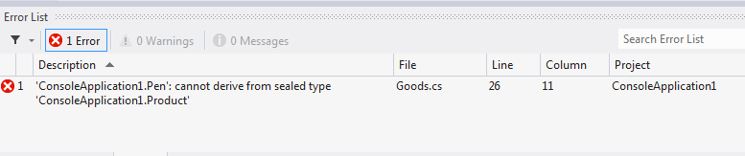
Sealed Classes 3-3
The class Pen tries to inherit the sealed class Product, the C#
compiler generates an error, as shown in the following figure:

Slide 42
Purpose of Sealed Classes
Consider a class named SystemInformation that consists of
critical methods that affect the working of the operating system.
You might not want any third party to inherit the class SystemInformation and override its methods, thus, causing security and copyright issues.
Here, you can declare the SystemInformation class as sealed to prevent any change in its variables and methods.

Slide 43
Guidelines
Sealed classes are restricted classes that cannot be inherited where the list depicts the conditions in which a class can be marked as sealed:
🞛 If overriding the methods of a class might result in unexpected functioning of the class.
🞛 When you want to prevent any third party from modifying your class.

Slide 44
Sealed Methods 1-3
A sealed class cannot be inherited by any other class.
In C#, a method cannot be declared as sealed.
When the derived class overrides a base class method, variable, property or event, then the new method, variable, property, or event can be declared as sealed.
Sealing the new method prevents the method from further overriding.
An overridden method can be sealed by preceding the override keyword with the sealed keyword.
The following syntax is used to declare an overridden method as sealed:
Syntax
sealed override <return_type> <MethodName>{}
where,
🞛 return_type: Specifies the data type of value returned by the method.
🞛 MethodName: Specifies the name of the overridden method.

Slide 45
Sealed Methods 2-3
The following code declares an overridden method Print() as sealed:
Snippet
using System;
class ITSystem
{
public virtual void Print()
{
Console.WriteLine (“The system should be handled carefully”);
}
}
class CompanySystem : ITSystem
{
public override sealed void Print()
{
Console.WriteLine (“The system information is confidential”);
Console.WriteLine (“This information should not be overridden”);
}
}
class SealedSystem : CompanySystem
{
public override void Print()
{
Console.WriteLine (“This statement won’t get executed”);
}
static void Main (string [] args)
{
SealedSystem objSealed = new SealedSystem(); objSealed.Print ();
}
}

Slide 46
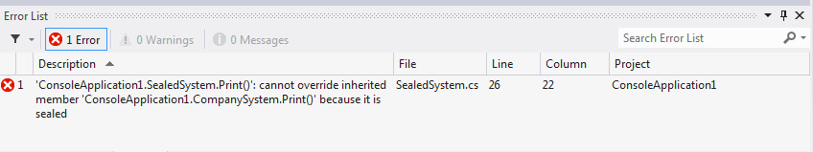
Sealed Methods 3-3
In the code:
🞛 The class ITSystem consists of a virtual function Print().
🞛 The class CompanySystem is inherited from the class ITSystem.
🞛 It overrides the base class method Print().
🞛 The overridden method Print() is sealed by using the sealed keyword, which
prevents further overriding of that method.
🞛 The class SealedSystem is inherited from the class CompanySystem.
🞛 When the class SealedSystem overrides the sealed method Print(), the C#
compiler generates an error as shown in the following figure:

Slide 47
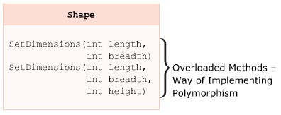
Polymorphism
Polymorphism is the ability of an entity to behave differently in different situations.
Polymorphism is derived from two Greek words, namely Poly and Morphos, meaning forms. Polymorphism means existing in multiple forms.
The following methods in a class have the same name but different signatures that perform the same basic operation but in different ways:
🞛 Area(float radius)
🞛 Area(float base, float height)
These methods calculate the area of the circle and triangle taking different parameters and using different formulae.
Example
Polymorphism allows methods to function differently based on the parameters and their data types. The following figure displays the polymorphism:

Slide 48
Implementation 1-3
Polymorphism can be implemented in C# through method overloading and
method overriding.
You can create multiple methods with the same name in a class or in different classes having different method body or different signatures.
Methods having the same name but different signatures in a class are referred to as overloaded methods. The same method performs the same function on different values.
Methods inherited from the base class in the derived class and modified within the derived class are referred to as overridden methods. Only the body of the method changes in order to function according to the required output.

Slide 49
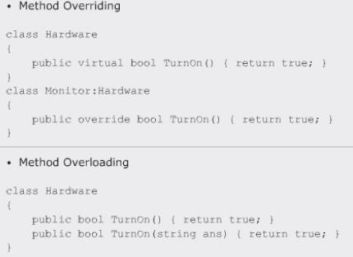
Implementation 2-3
The following figure displays the implementation:
Figure 7.11: Implementation

Slide 50
Implementation 3-3
The following code demonstrates the use of method overloading feature:
Snippet
class Area
{
static int CalculateArea(int len, int wide)
{
return len * wide;
}
static double CalculateArea(double valOne, double valTwo)
{
return 0.5 * valOne * valTwo;
}
static void Main(string[] args)
{
int length = 10; int breadth = 22; double tbase = 2.5;
double theight = 1.5;
Console.WriteLine(“Area of Rectangle: “ + CalculateArea(length, breadth)); Console.WriteLine(“Area of triangle: “ + CalculateArea(tbase, theight));
}
}
In the code:
🞛 The class Area consists of two static methods of the same name, CalculateArea.
However, both these methods have different return types and take different parameters.
Output
Area of Rectangle: 220 Area of triangle: 1.875

Slide 51
Compile-time and Run-time Polymorphism 1-3
Polymorphism can be broadly classified into the following categories:
🞛 Compile-time polymorphism
🞛 Run-time polymorphism
The following table differentiates between compile-time and run-time
polymorphism:
Compile-time Polymorphism | Run-time Polymorphism
Is implemented through method overloading. | Is implemented through method overriding.
Is executed at the compile-time since the compiler knows which method to execute depending on the number of parameters and their data types. | Is executed at run-time since the compiler does not know the method to be executed, whether it is the base class method that will be called or the derived class method.
Is referred to as static polymorphism. | Is referred to as dynamic polymorphism.

Slide 52
Compile-time and Run-time Polymorphism 2-3
The following code demonstrates the implementation of run-time polymorphism:
Snippet
using System;
class Circle
{
protected const double PI = 3.14; protected double Radius = 14.9; public virtual double Area()
{
return PI * Radius * Radius;
}
}
class Cone : Circle
{
protected double Side = 10.2; public override double Area()
{
return PI * Radius * Side;
}
static void Main(string[] args)
{
Circle objRunOne = new Circle(); Console.WriteLine(“Area is: “ + objRunOne.Area()); Circle objRunTwo = new Cone(); Console.WriteLine(“Area is: “ + objRunTwo.Area());
}
}

Slide 53
Compile-time and Run-time Polymorphism 3-3
In the code:
The class Circle initializes protected variables and contains a virtual method Area()that returns the area of the circle.
The class Cone is derived from the class Circle, which overrides the
method Area().
The Area()method returns the area of the cone by considering the length of the cone, which is initialized to the value 10.2.
The Main() method demonstrates how polymorphism can take place by first creating an object of type Circle and invoking its Area()method and later creating a reference of type Circle but instantiating it to Cone at runtime and then calling the Area()method.
In this case, the Area()method of Cone will be called even though the reference created was that of Circle.
Output
Area is: 697.1114
Area is: 477.2172

Slide 54
Summary
Inheritance allows you to create a new class from another class, thereby inheriting its common properties and methods.
Inheritance can be implemented by writing the derived class name followed by a colon and the name of the base class.
Method overriding is a process of redefining the base class methods in
the derived class.
Methods can be overridden by using a combination of virtual and override keywords within the base and derived classes respectively.
Sealed classes are classes that cannot be inherited by other classes.
You can declare a sealed class in C# by using the sealed keyword.
Polymorphism is the ability of an entity to exist in two forms that are compile-time polymorphism and run-time polymorphism.

